Slide 1
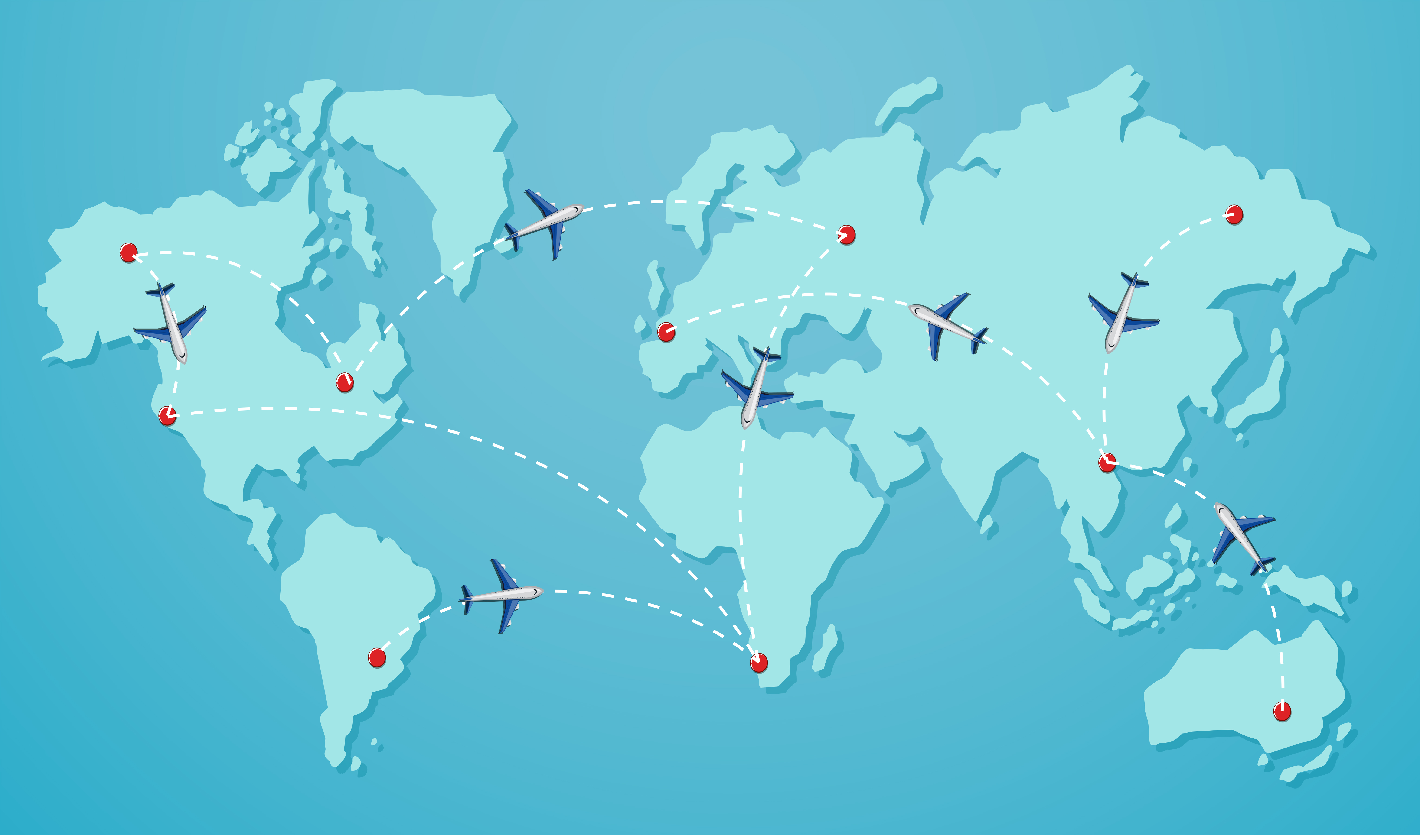
What comes to your mind while Seeing Picture?

Slide 2

MAKE
MY
TRIP

Slide 3
x
“A Year without trip is like a life without joy"

Slide 4

LOGO
This could be the part of the presentation where you can introduce yourself, write your email...

Slide 5
TABLE OF CONTENTS
01
02
03
04
INTRODUCTION
DESTINATIONS
You could describe the topic of the section here
You could describe the topic of the section here
PLANNING
CONCLUSION
You could describe the topic of the section here
You could describe the topic of the section here

Slide 6

01
INTRODUCTION

Slide 7
BOOKINGS
Flight, Bus ,Train Booking
Hotel Booking
Domestic and international tickets
Online hotel bookings with over 45,000 properties globally.

Slide 8

TECHNOLOGY AND INNOVATIONS
MOBILE APP
ARTIFICIAL INTELLIGENCE
PAYMENT SOLUTIONS
One stop solution for hotels, flights ,train ,bus booking
AI –driven recommendation based on preference
UPI, Wallets, Credit/debit cards, EMI

Slide 9
02
DESTINATION

Slide 10
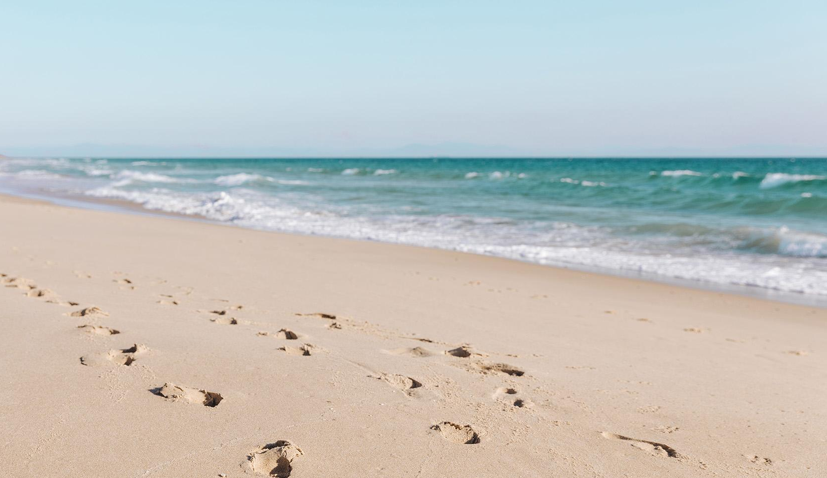
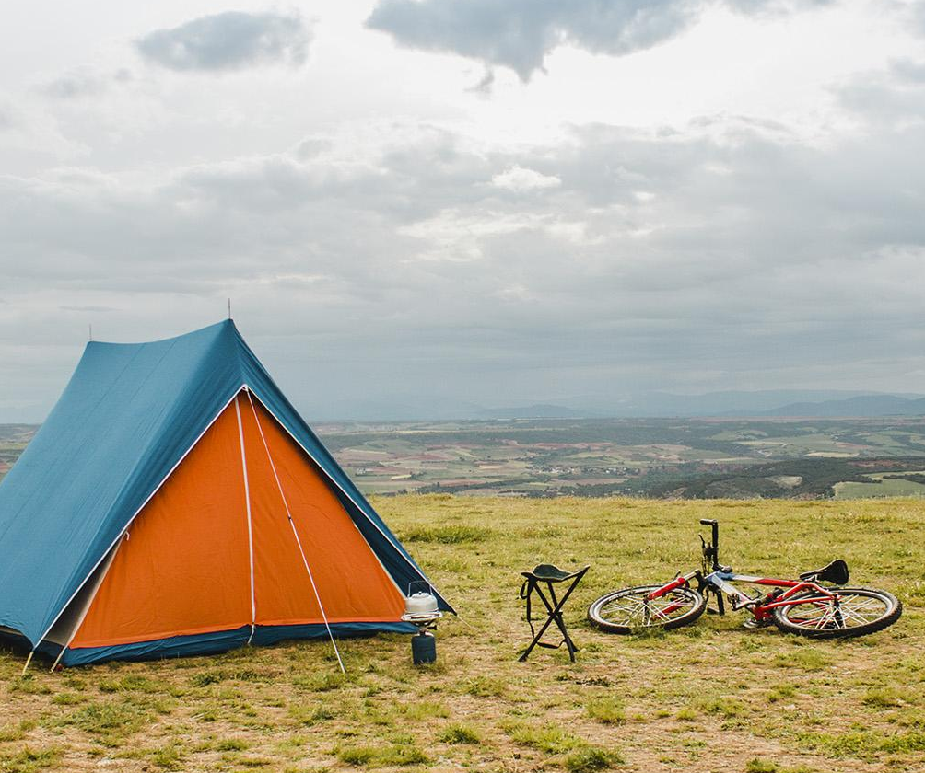
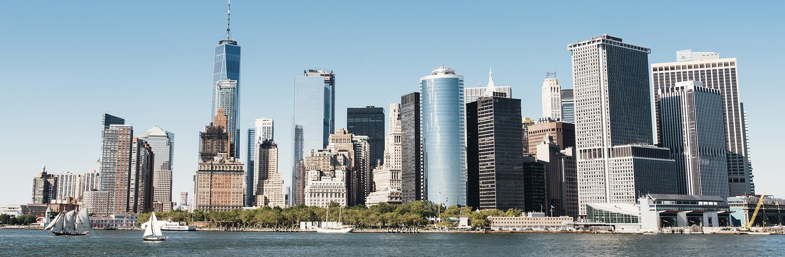
PICTURES OF DESTINATIONS

Slide 11
INFOGRAPHICS MAKE YOUR IDEA
UNDERSTANDABLE...
FAVORITE DESTINATIONS
TRAVELERS
60% of women and 40% of men are going to travel soon

Slide 12
TOURIST PLACES

Slide 13
Products and Services
Flight bookings Hotel Stay Holiday Packages Bus and Train tickets Activities

Slide 14
03
PLANNING

Slide 15
Future Plan
Investing in Technology
Sustainability

Slide 16
04
CONCLUSION

Slide 17
Conclusion
Most popular travel Platform
Expanding Services
Easily accessible

Slide 18
THANK YOU

